Slide 1

10ALYTICS
SALES PERFOMANCE ANALYSIS

Slide 2
PROBLEM STATEMENT
Which demographics have the most valuable customers.
2. What are the distinct customer segments based on age, gender, and purchasing behavior.
3. What are the most profitable product categories and sub-categories
4. Are there any regional variations in sales and profitability.
5. Are there any seasonal patterns in sales and how do we adjust inventory or marketing strategies accordingly.

Slide 3
Analysis Questions
Which demographic factors (age, gender, etc.) are associated with higher spending? How can marketing efforts be tailored to attract and retain these valuable customer segments?
Are there specific customer segments that contribute significantly to overall sales, and how can marketing strategies be tailored for each segment?
Which products contribute the most to overall profit, and are there opportunities to optimize pricing or marketing strategies for less profitable products?
Are there specific states or regions where the business is performing exceptionally well or underperforming? What factors may contribute to these variations?
Are there specific times of the year when sales peak or dip? How can the business capitalize on seasonal trends and mitigate the impact of slow periods?

Slide 4
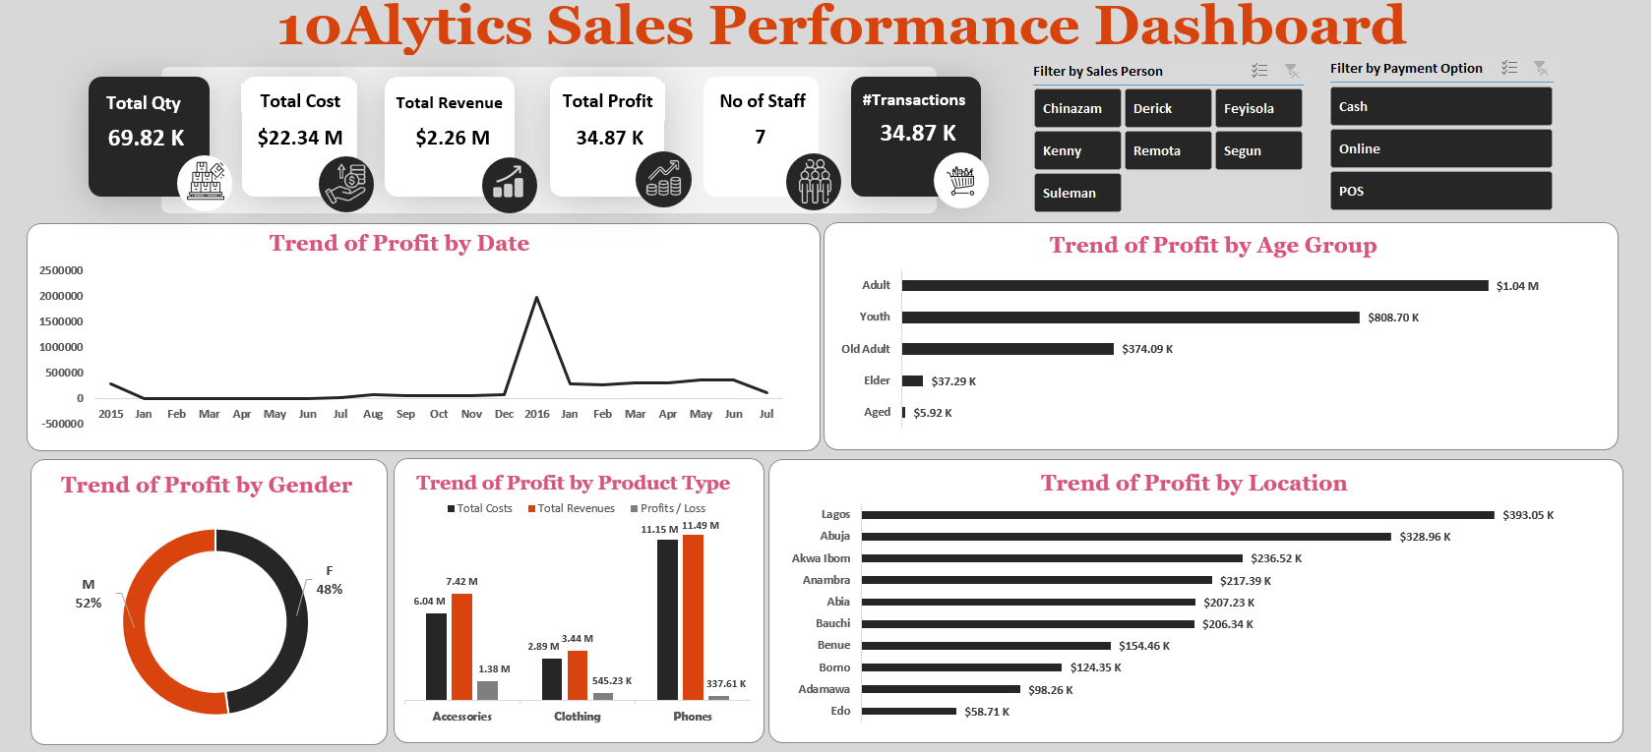

Slide 5
SUMMARY
The analysis reveals that Accessories, Clothing, and Phones are the top-performing product categories, contributing $1.38 million, $545.23 thousand, and $337.61 thousand to the overall profit, respectively.
Among the product categories, Phones generate the highest revenue, but the profit margin is relatively lower compared to Accessories and Clothing.
Regional variations in profitability are evident, with Edo, Adamawa, and Borno emerging as top-performing states. On the other hand, Lagos, despite high revenue, has lower profitability.
Monthly trends show a significant dip in profits during the early months of the year, particularly in January, February, and March. However, profits rebound
Gender-wise, both male and female customers contribute significantly to overall profits, with slightly higher contributions from males. In terms of age groups, the Youth and Adult segments are the most profitable, suggesting targeted marketing efforts towards these demographics.

Slide 6
SOLUTIONS AND RECOMMENDATIONS
Implement targeted marketing campaigns for each product category. Consider bundling products or introducing promotions to boost sales in less profitable categories, such as Phones.
Evaluate the pricing strategy for Phones and explore opportunities for cost optimization. Consider introducing premium versions or upselling accessories to increase profitability.
Conduct a detailed analysis of factors contributing to success in high-performing states. Develop targeted marketing strategies for less profitable regions, addressing specific customer needs or preferences.
Plan inventory, marketing, and promotional activities to align with seasonal trends. Consider introducing special promotions during slow periods to stimulate sales.
Tailor marketing messages to resonate with both male and female customers. Develop targeted campaigns for the Youth and Adult segments, emphasizing product features and benefits that align with their preferences.

